Slide 1
Gun Violence Analysis
Project Group - 2
Kevin McConchie
Kinlay Denning
Denise Demirkol
Aija Dowling
Notes:
We designed this template so that each member of the project team has a set of slides with its own theme. Members, here’s how you add a new slide to just your set:
Mark where you want to add the slide: Select an existing one in the Thumbnails pane, click the New Slide button, then choose a layout. The new slide gets the same theme as the other slides in your set.
Careful! Don’t annoy your fellow presenters by accidentally changing their themes. That can happen if you choose a different theme from the Design tab, which changes all of the slides in the presentation to that look.

Slide 2
Motivation & Summary
Motivation:
We wanted to get a better understanding of the gun violence situation in the United States as a result of recent events.
Questions:
Who were the participants in gun violence?
What were the total number of kills by location.
How many people were hurt or killed?
What is the trend for gun violence over time?
Results:
We managed to answer most of our questions and found new questions to ask while analysing the data.

Slide 3
Questions and Data Source
Questions:
Data description and source:
What states are the most dangerous?
What are the 10 most dangerous cities?
What are 10 safest cities?
What portion of the killings were classed a mass shooting?
Where did mass shootings took place?
Who in society is most likely to participate in gun violence?
How did the number of gun killings change over time?
Comprehensive record of over 260k US gun violence incidents from 2013-2018
https://www.kaggle.com/datasets/jameslko/gun-violence-data

Slide 4
State / City deaths & Injuries
What states are the most dangerous?
What are the 10 most dangerous cities?
What are 10 safest cities?
Notes:
We designed this template so that each member of the project team has a set of slides with its own theme. Members, here’s how you add a new slide to just your set:
Mark where you want to add the slide: Select an existing one in the Thumbnails pane, click the New Slide button, then choose a layout. The new slide gets the same theme as the other slides in your set.
Careful! Don’t annoy your fellow presenters by accidentally changing their themes. That can happen if you choose a different theme from the Design tab, which changes all of the slides in the presentation to that look.

Slide 5
Data Cleanup & Exploration
Straightforward data manipulation - the source required little cleaning for the data I was looking into.
I didn’t anticipate sheer number of that had little to no incidents of gun violence.
City outliers were to be the focus rather than ignored.
Problems encountered:
The volume of little to no incidents skewing the data so heavily
Finding a useful way interpreting the data for cities

Slide 6
Data Analysis
Extremely dangerous states for being killed by a gun: California & Texas
Extremely dangerous state for being injured by a gun: Illinois
Deadliest cities by rank: Chicago, Houston, Baltimore, Saint Louis, Philadelphia, New Orleans, Los Angeles, Memphis, Indianapolis, Detroit
r value for injuries vs kills is 0.86, meaning there’s a very strong positive correlation between people shot or killed.(not a surprise)
11,500 out of 12,898 cities had less than 5 kills
Cities with outliers for kills and injuries were 1398, 1645 respectively.

Slide 7
Discussion
I expected to see a strong correlation between injuries and deaths
I didn’t expect to find a huge volume of cities to be so safe.
The cities I thought would be dangerous are way more deadly than anticipated.
Targeting the dangerous cities rather than a state or national level is likely to have a better impact on reducing gun violence.

Slide 8
Post Mortem
Difficulties that arose:
fixing the location of a single plot tick
Losing a code windows in VSCode Jupyter windows when I hit ctrl-z
Dark mode causing issues with viewing plots and png files
Additional research:
Look deeper into the outlier cities.
Look at the impact of all outliers on gun violence incidents.
Look at the geography of the cities versus political affiliation at a city level
Look at population density and its possible impact

Slide 9
Gun Violence Timeseries
Kinlay Denning

Slide 10
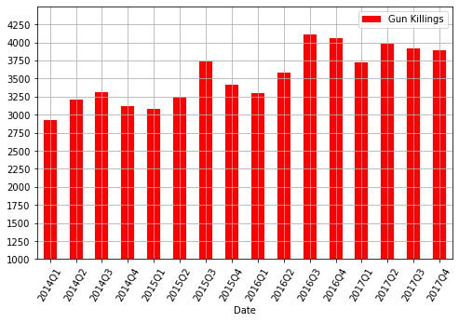
Gun Killings: An Overview
Data Cleanup:
The file included suspiciously incomplete data from 2013. This was excluded from the analysis for consistency. The first four months of 2018 was excluded so that seasonality could be better represented.
A challenge was representing the data in such a way that expressed a cleaner overall trend:
sorting the number of gun killings by day returned a visualisation that did not clearly show any long-run trend
sorting by month returned a visualisation that over emphasised the degree to which the number of killings varied from month to month
Analysis:
There appears to be a clear upward trend in the number of gun killings for the period.
However this prompts more questions than answers:
Has the proportion of gun killings increased with the number of incidents of gun violence
Is seasonality a factor in the gun violence data?

Slide 11
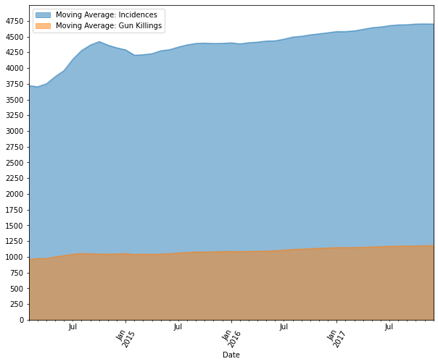
Incidents of Gun Violence vs. Killings
Data Cleanup:
Data cleanup for this section involved sorting the number of incidences and number of killings by month.
Analysis:
The area graph plots a moving average of the number of incidents, and as a proportion of this, the average number of gun killings per month
There is a clear upward trend in the number of incidents involving gun violence. This is consistent with the increase we see in the number of gun killings.

Slide 12
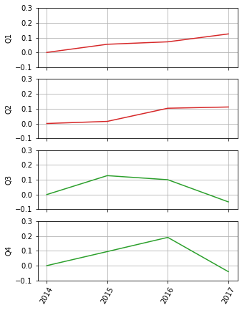
Quarterly Change in Gun Killings
Analysis:
For this section I wanted to focus on illuminating any seasonal trends in the data
My thinking around this was to compare similar periods of the data to each other. In the first bar graph, it shows a clear pattern in the way gun killings tend to increase in the second and third quarters, and a decrease in the fourth quarter and first quarters
The four corresponding line-plots illustrate the percentage change in the number of gun killings for each quarter
The trend in the first and second quarter show an overall increase in the number of gun killings over the period
The trend in the third and fourth quarter show a percent decrease in 2017 in the number of gun killings for the quarter, despite the total amount increase of gun killings that was illustrated in the first graph
A limitation of this analysis is that while this may mean that gun violence may be slowing down, there are too many confounders in the data to confirm whether this the actual trend that is being expressed in the data.

Slide 13
Aija’s Section
Group member name

Slide 14
Supporting content
Questions:
The data provided the number of people killed and injured at each incident.
I examined the number of Mass killings. To see if there was any pattern in where these took place.
Mass killings are defined as 4 or more people killed or injured (not including the shooter) at each incident.
Mass killings by state are graphed and show that some states are overrepresented for this type of shooting incident.

Slide 15
Data observations

Slide 16
Data Observations
Optional statement

Slide 17
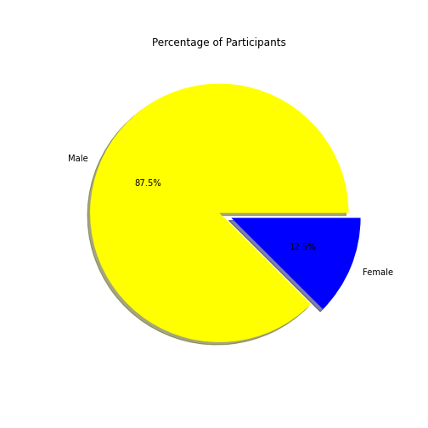
Who is the most impacted group in the incidents?
Question: Who in society is most likely to be a participant in a crime?
Outcome: Females participated much less criminal incidents and than male.
Female: 12.5%
Male: 87.5%
Participant: A person who involved in an incident as a suspect or victim.

Slide 18
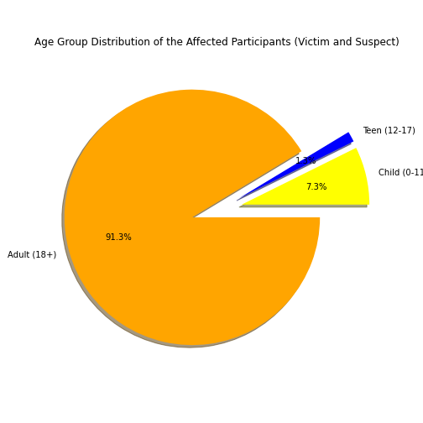
Who is the most impacted group in the incidents?
Adults (18+) participated in gun violence significantly higher than the other age groups.
Adult (18+): 91.3%
Teen (12-17): 1.3%
Child (0-11): 7.3%
Participant: A person who involved in an incident as a suspect or victim.

Slide 19
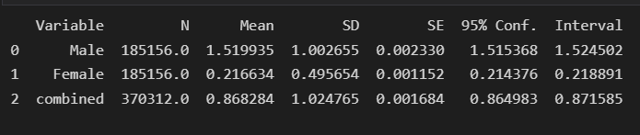
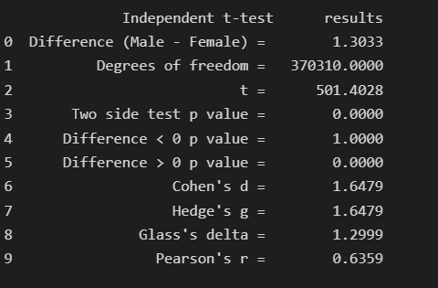
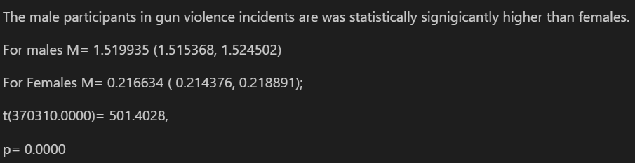
Hypothesis : Males participated more than females in gun violent crimes.

Slide 20
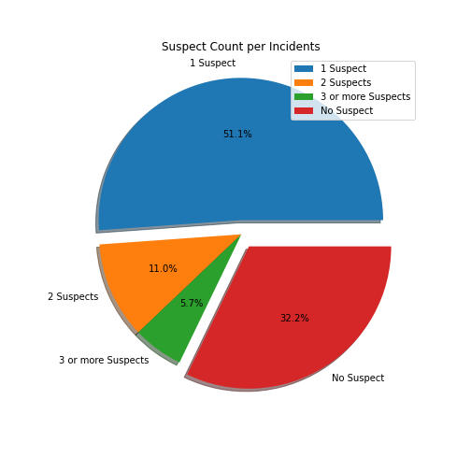
How likely to capture the gun violence suspects before the writing the incident report?
Question: How likely to capture the gun violence suspects before the writing the incident report?
Outcome:
For 67.8% of the incidents, at least one suspect was captured before the incident report.
For 32.2% of the incidents, suspect(s) were not captured before the incident report.

Slide 21
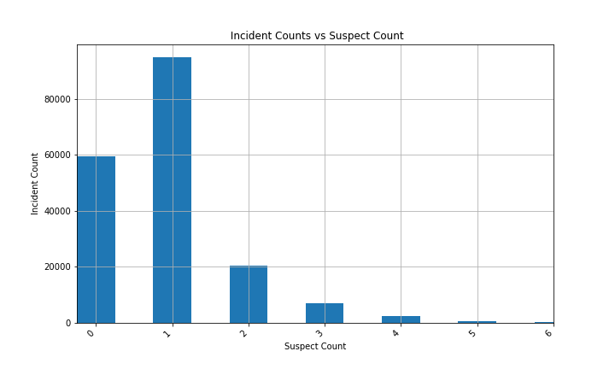
How likely to capture the gun violence suspects before the writing the incident report?
For most of the incidents, a single suspect was captured before the incident report.

Slide 22
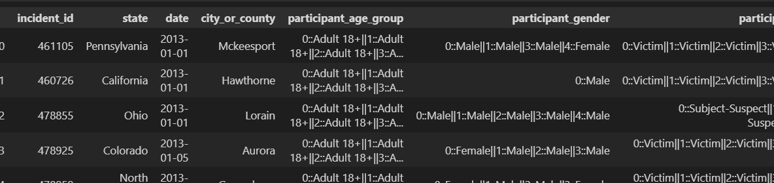
Data Needs and Processing
In order to respond to gender and age distribution of the participants, I needed to process the data in the participant_age_group and participant_gender columns, and capture the counts.
I initially processed created a detail dataframe for incidents, where each participant was a separate row with related information. Despite this would give more insight into the data (victim and suspect level information), I left this approach because it takes 50 minutes to create the detail dataframe.
I tried the CENSUS api to download the median income for counties, however the city_or_country column doesn’t match with the CENSUS filter. I didn’t include it in the data.
In order to be able to use “choropleth”, I used a dictionary to convert state names to state codes.

Slide 23
Post Mortem
If I had 2 more weeks,
I’d find the county information based on city_or_county data using the following API:
url = fhttps://geo.fcc.gov/api/census/area?lat={lat}&lon={lon}&censusYear=2020&format=json
I’d spent more time effective data processing

Slide 24
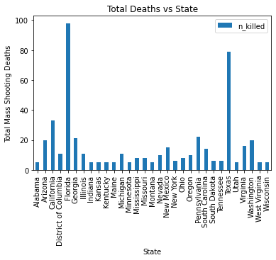
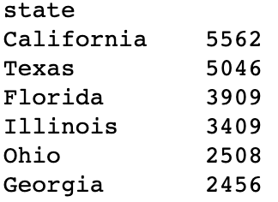
Total Mass Shooting Deaths in The United States by State. Total Mass Shootings Are Shootings In Which Four or More People are Killed.
1.
Most states have have experienced less than 30 deaths. Florida and Texas experience the most, both states have a much higher than average rate of deaths.
2.
We can see from the image below that whilst California has the most gun deaths - most of these deaths are not from mass shootings.
Total Shooting Deaths - Top 6 States

Slide 25
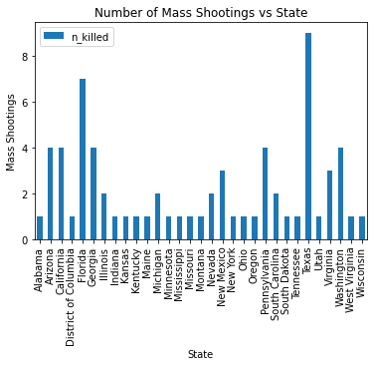
Total Mass Shooting Deaths in The United States by State.

Slide 26
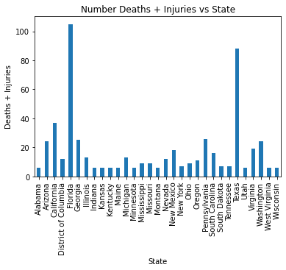
Total Mass Shooting Deaths and Injuries by State.
.

Slide 27
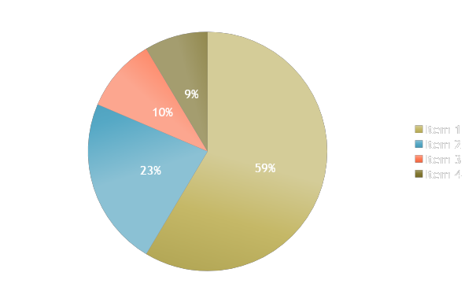
Data Observations
Optional statement

Slide 29
Open-floor Q&A
Ask away!

